Slide 1

Transforming Libraries to Library Learning Commons’
April 2021

Slide 2
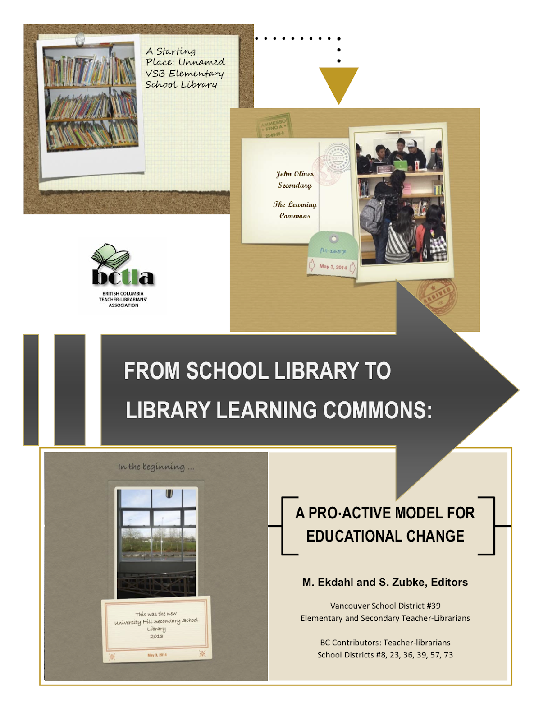

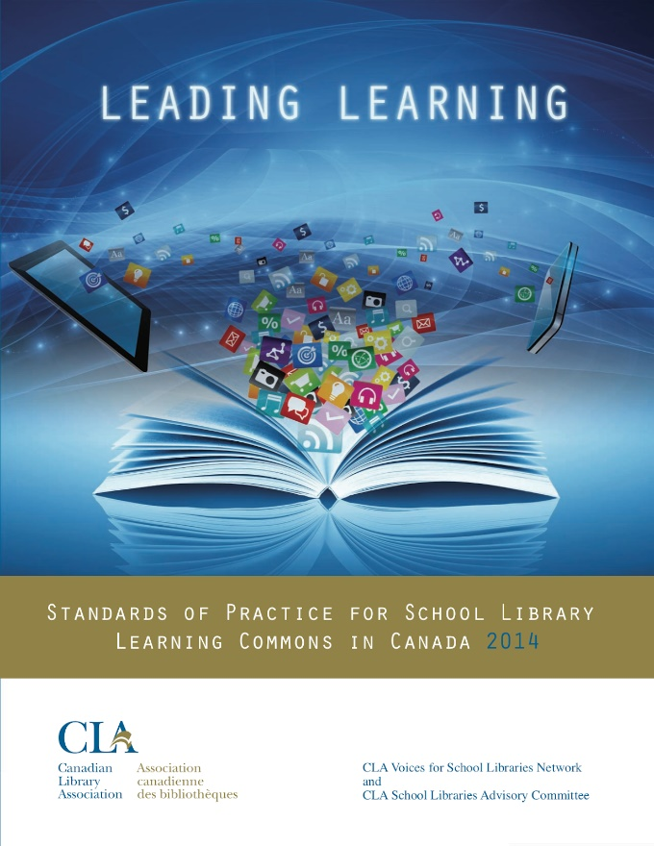
Why a Library Learning Commons Model?
Notes:
Each image is linked to the document in question

Slide 3
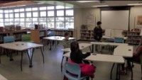
Why a Library Learning Commons Model?
Notes:
Here is the link to the video. https://www.youtube.com/watch?v=7ftD_V_tDsQ At times, videos aren't super cooperative while using Teams. The link can be emailed or put into the chat function.

Slide 4
Why a Library Learning Commons Model?
Leads to better use of space in schools​
Supports inquiry-based/project-based/cross curricular learning
Encourages competency focused learning
Increases student engagement & achievement​
Fosters literacies (e.g. traditional, numerical, digital, etc.)
Cultivates a collaborative culture
Based on evidence presented in “From School Library to Library Learning Commons” & “Leading Learning”

Slide 5
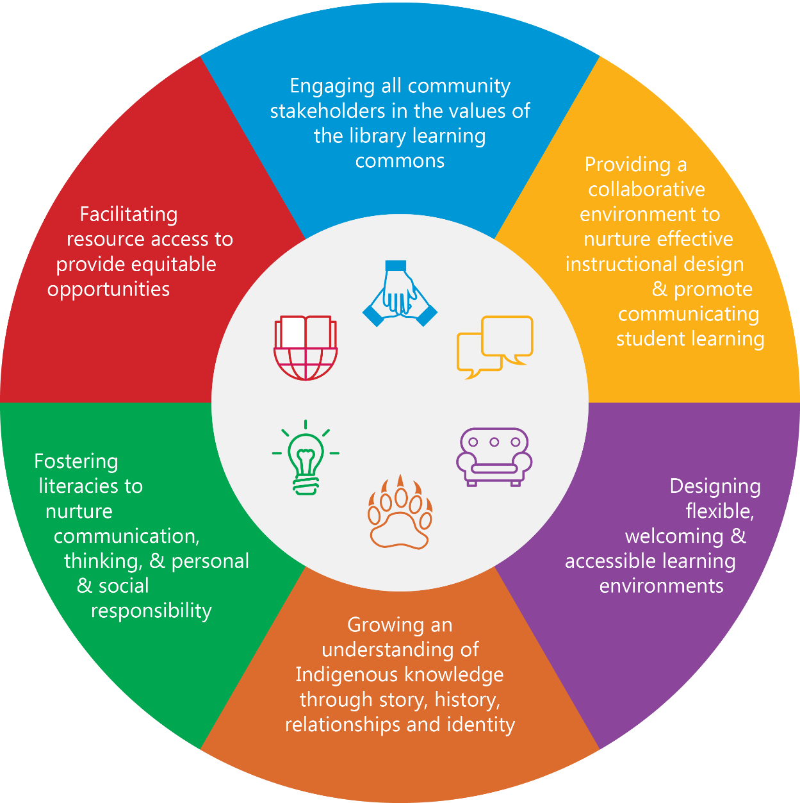
SD22 Library Learning Commons Core Values

Slide 6

Facilitating resource access to provide equitable opportunities
Provides access that is physical, virtual and equitable.
Begins with a responsive and dynamic school library program.
Provides balanced, rich, diverse, current, and professionally curated collections of print and digital resources.
Consists of a physical and virtual space that enables access to tools, resources, and services.
Notes:
Please link this value back to a practical application for your teachers. An example could be working with the TL to find digital or physical resources to best support learning experiences that develop the curricular and core competencies.

Slide 7

Engaging all community stakeholders in the values of the library learning commons
Establishes a shared understanding that educational change is meaningful and important.
Ensures professional commitment to innovative practice and collaborative implementation of new designs for learning.
Places value on a collaborative and participatory school environment.
Provides opportunities for all stakeholders to engage in the development of the library learning commons program
Notes:
Please link this value back to a practical application for your teachers. For example, an option could be participating in a Learning Commons Committee to help guide the direction of the Learning Commons space/resources or bringing in community stakeholders to participate in development of the learning commons.

Slide 8

Providing a collaborative environment to nurture effective instructional design & promote communicating student learning
Provides space, resources and expertise to co-design new, original and inspired learning opportunities based on inquiry.
Supports goals for learning that are based on current research, unique needs, and well-designed, purposeful, and powerful intentions.
Encourages a culture of collaboration in the school community.
Gives students & teachers opportunities to explore modes of demonstrating and communicating learning.
Notes:
Please link this value back to a practical application for your teachers. An example could be teachers partnering and co-planning with the TL to develop and deliver innovative new learning experiences for students or working together in a design challenge and maker space learning experience.

Slide 9

Designing flexible, welcoming & accessible learning environments
Provides a welcoming, safe, open, inclusive and supportive place.
Values mobility and flexibility of design within the space and in the opportunities for learning.
Includes quiet reading or study areas and informal social learning areas for individual or group work.
Notes:
Please link this value back to a practical application for your teachers. An example could be using the space as an extension of your classroom for accessible and inclusive activities like yoga or the map exercise or a science experiment.

Slide 10

Growing an understanding of Indigenous knowledge through story, history, relationships and identity
Develops knowledge through story, history, relationships and identity.
Reflects Indigenous knowledge and culture throughout the space.
Makes connections with the community and nature.
Integrates Indigenous texts into the resource collection.
Connects with AbEd lead teachers for classroom resources.
Develops a working knowledge of Indigenous resources.
Notes:
Please link this value back to a practical application for your teachers. An example could be bring in local indigenous resources and contacts to engage students in learning experiences.

Slide 11

Fostering literacies to nurture communication, thinking, & personal & social responsibility
Supports teachers in designing personalized, flexible, with choice-based learning experiences.
Makes connections across curricula, place and experiences.
Focuses on concepts and curricular competencies (questioning, analysis, supporting with evidence, ethics).
Encourages the core competencies (communication, thinking, personal and social awareness & responsibility).
Fosters development of literacies (e.g. reading & writing, numerical, digital, etc.).
Notes:
Please link this value back to a practical application for your teachers. An example could be students displaying evidence of learning which showcases their core or curricular competency development.

Slide 12
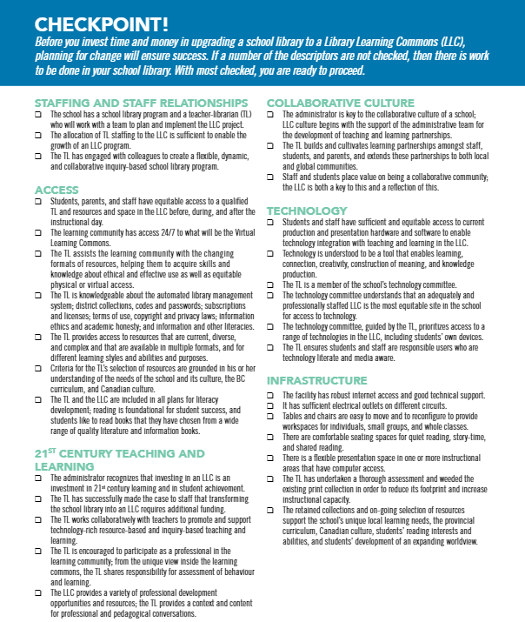
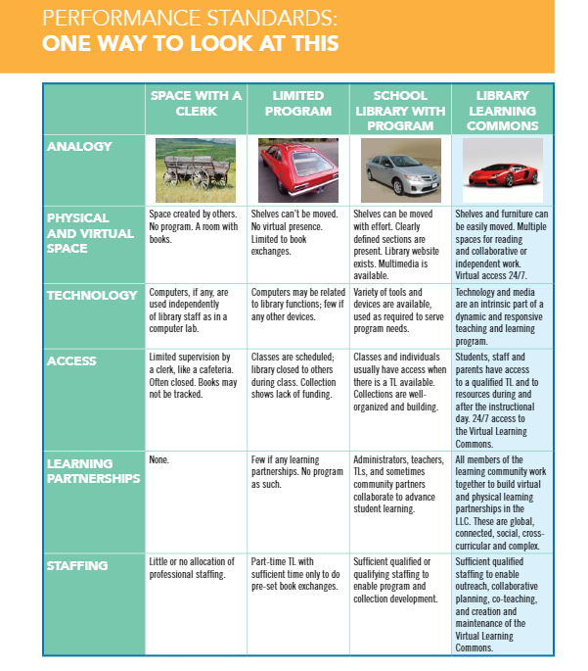
Next Steps
Start talking. Get people involved in the discussion! – remember the values. (discussion starters – p. 29 From "Leading Learning")
Refer to the Learning Commons/Library progression "performance standards" - where is your space on the continuum? (p.6 From "School Library to Library Learning Commons")
Together, complete a Library Learning Commons needs assessment. (p.7 From "School Library to Library Learning Commons")
Find your entry point to start or continue the process and create a plan. (considerations - p.15 From "School Library to Library Learning Commons")
Complete an SD22 Library Learning Commons School Plan.

