Slide 1

Digital Citizenship and Online Safety
SD#22

Slide 2
Due Diligence
This presentation (or the messages within it) should be reviewed by all students prior to using any software (this includes web tools, apps (Windows, iOS, or Chrome), extensions, or add-ons) where personal data may be shared. Teachers may adjust the presentation to meet the needs of their classroom.
Students are required to have a signed Software/Digital Tools Informed Parent Consent Form on file. This form must be signed by parents/guardians annually. The form can be found on www.sd22learns.ca.

Slide 3
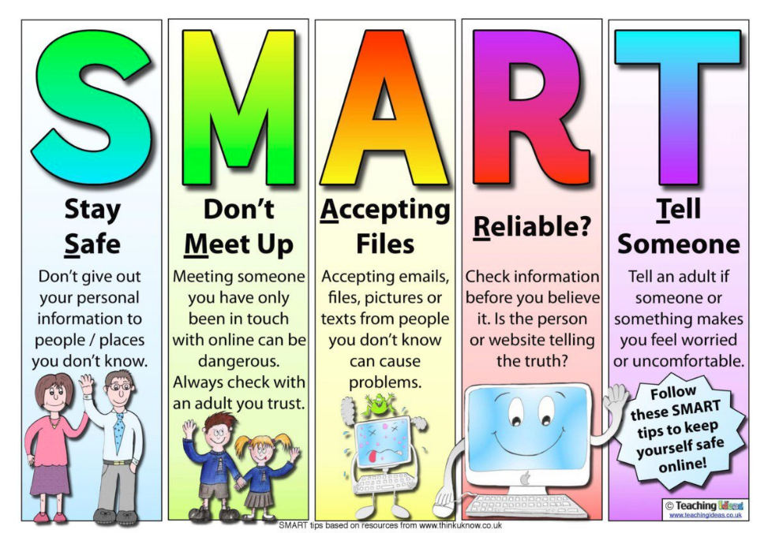
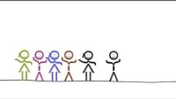
General Guidelines

Slide 4

Public, Persistent, Permanent
You should assume that electronic communication and tools are not private. It can be monitored, copied, and shared even if you are careful with ever changing privacy settings.
Your online content could positively or negatively affect your life right now and into the future. Consider carefully what and why you post.
Hitting the delete button may not make it go away.
Always THINK before you post!

Slide 5

Permission from Others
You are not to post personal information of or about others online.
Always ask permission before you take pictures or video of others.
Speak up if others take your image without permission.

Slide 6
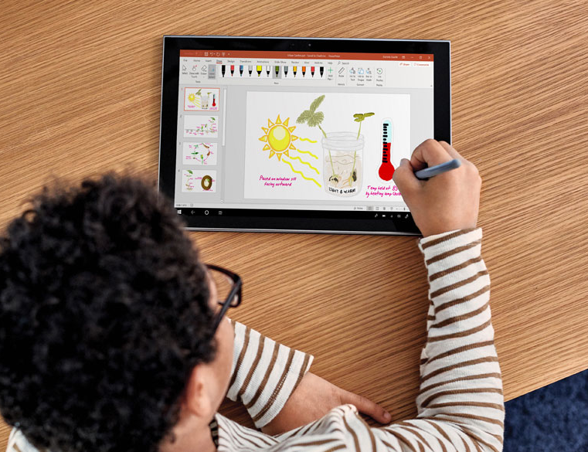
School Work Only
School devices and accounts are for schoolwork.
Follow the same classroom expectations online that you follow in the school. Be safe and keep others safe!
Be kind to others when collaborating digitally.
Be creative and have fun! Use technology to showcase your learning.

